Slide 1

Easter Seals Project

Slide 2
Easter Seals
We chose the Easter Seals because our school has worked closely with the charity before, so we believe and are very passionate about the cause.

Slide 3
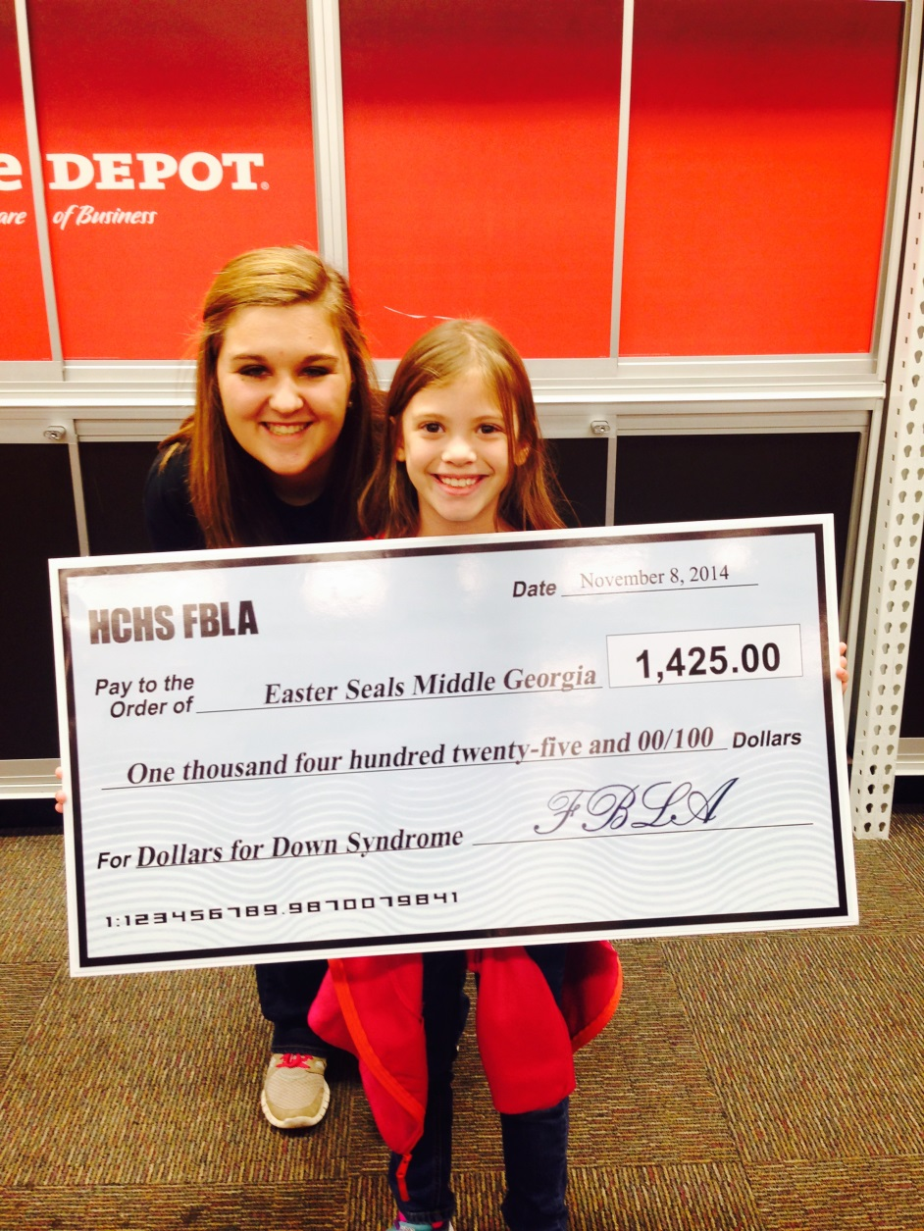
Dollars for Down Syndrome

Slide 4
Roles:
David Partin: Webmaster
Patrick Block: Code Control, Photo Editor, and Research
Anna Wilson: Research

Slide 5



Software Used:
Dreamweaver
Photoshop
Git Protocol

Slide 6
Copyright Information
We used official content from the national and regional Easter Seals website

Slide 7
Adobe Dreamweaver
We chose to use Adobe Dreamweaver because it is one of the leading Website Development programs in the industry.

Slide 8
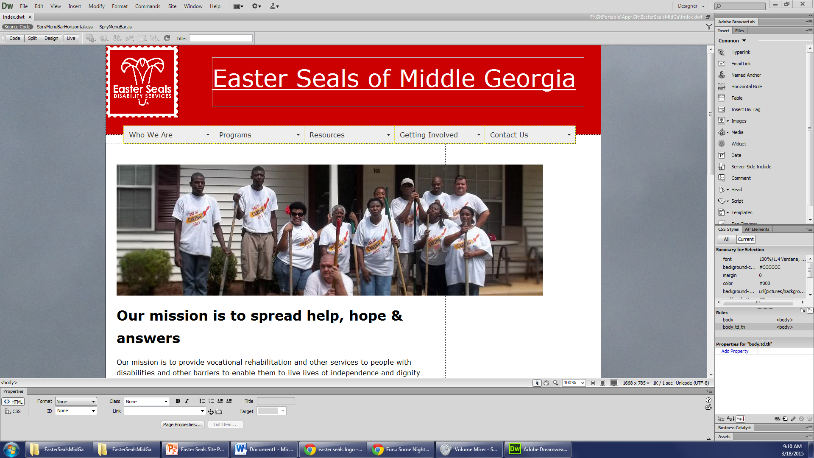
Using Dreamweaver

Slide 9
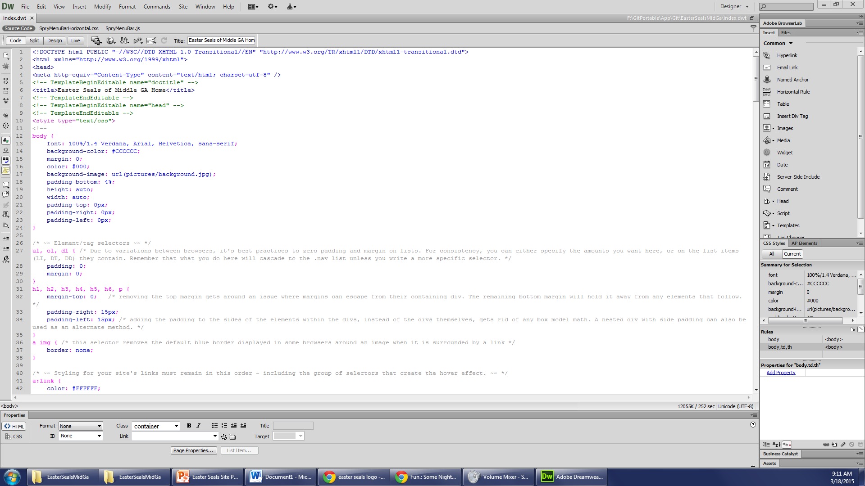
Using Dreamweaver

Slide 10
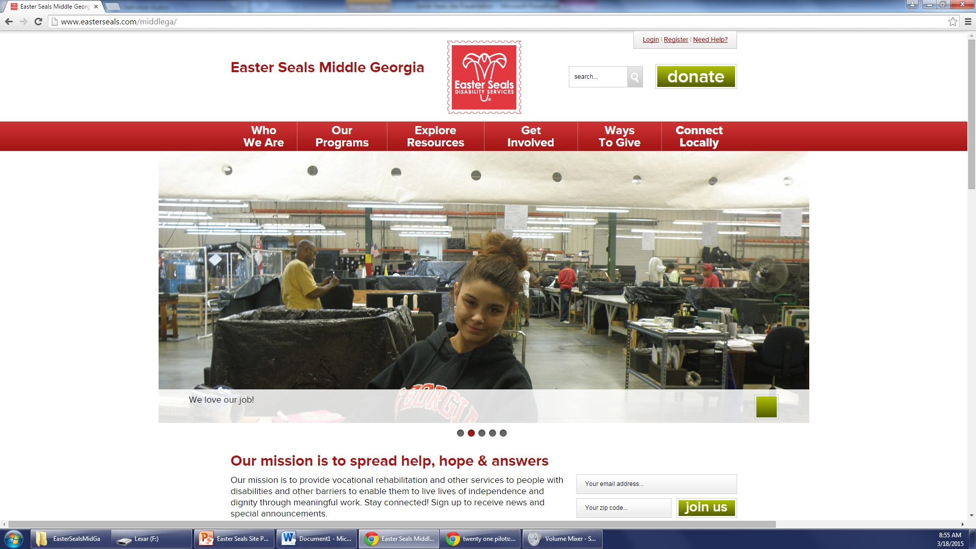
Official Original Regional Site

Slide 11
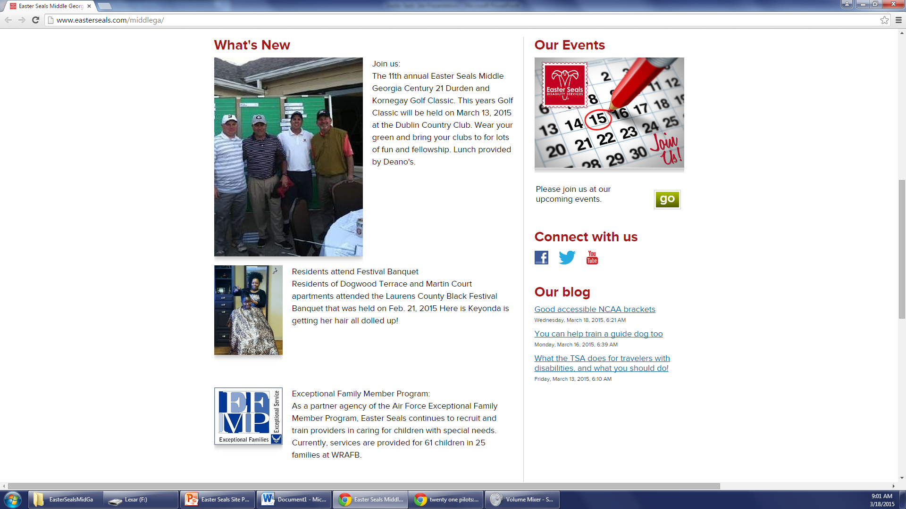
Official Original Regional Site

Slide 12
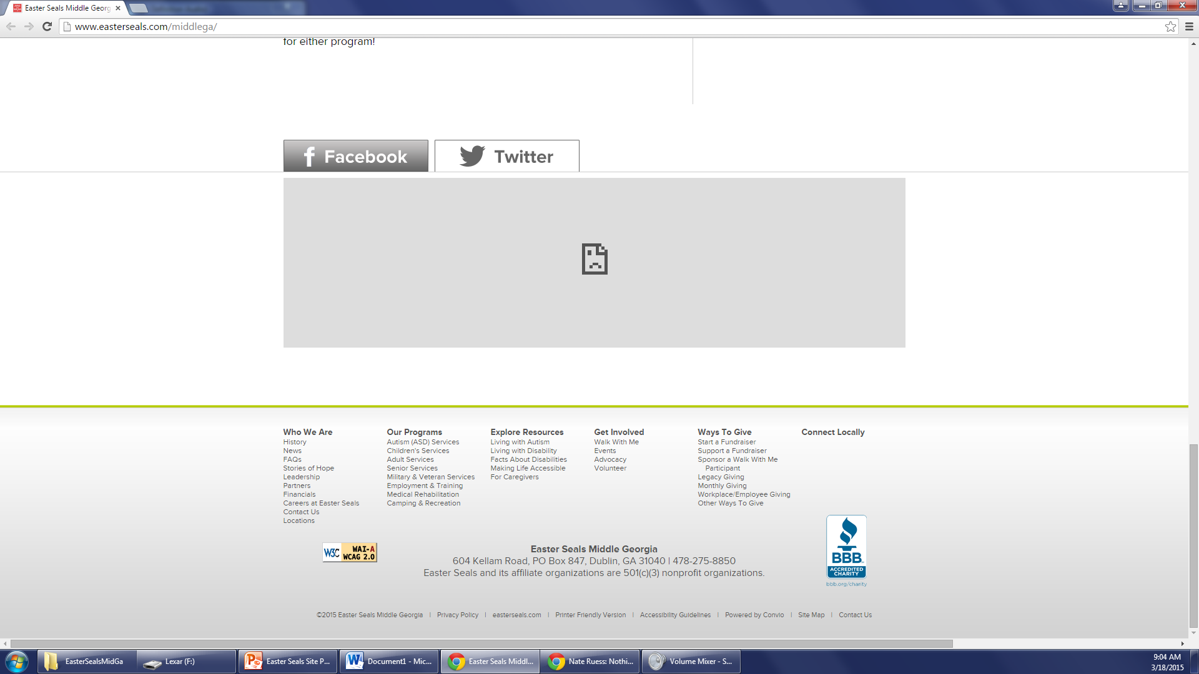
Official Original Regional Site

Slide 13
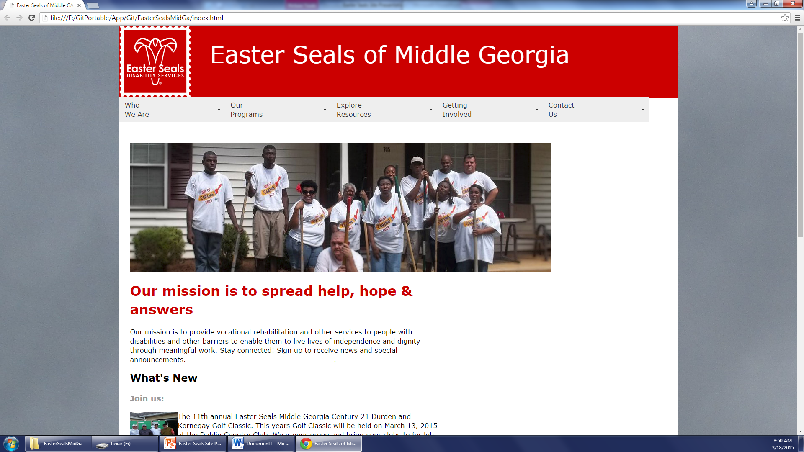
Our Site

Slide 14
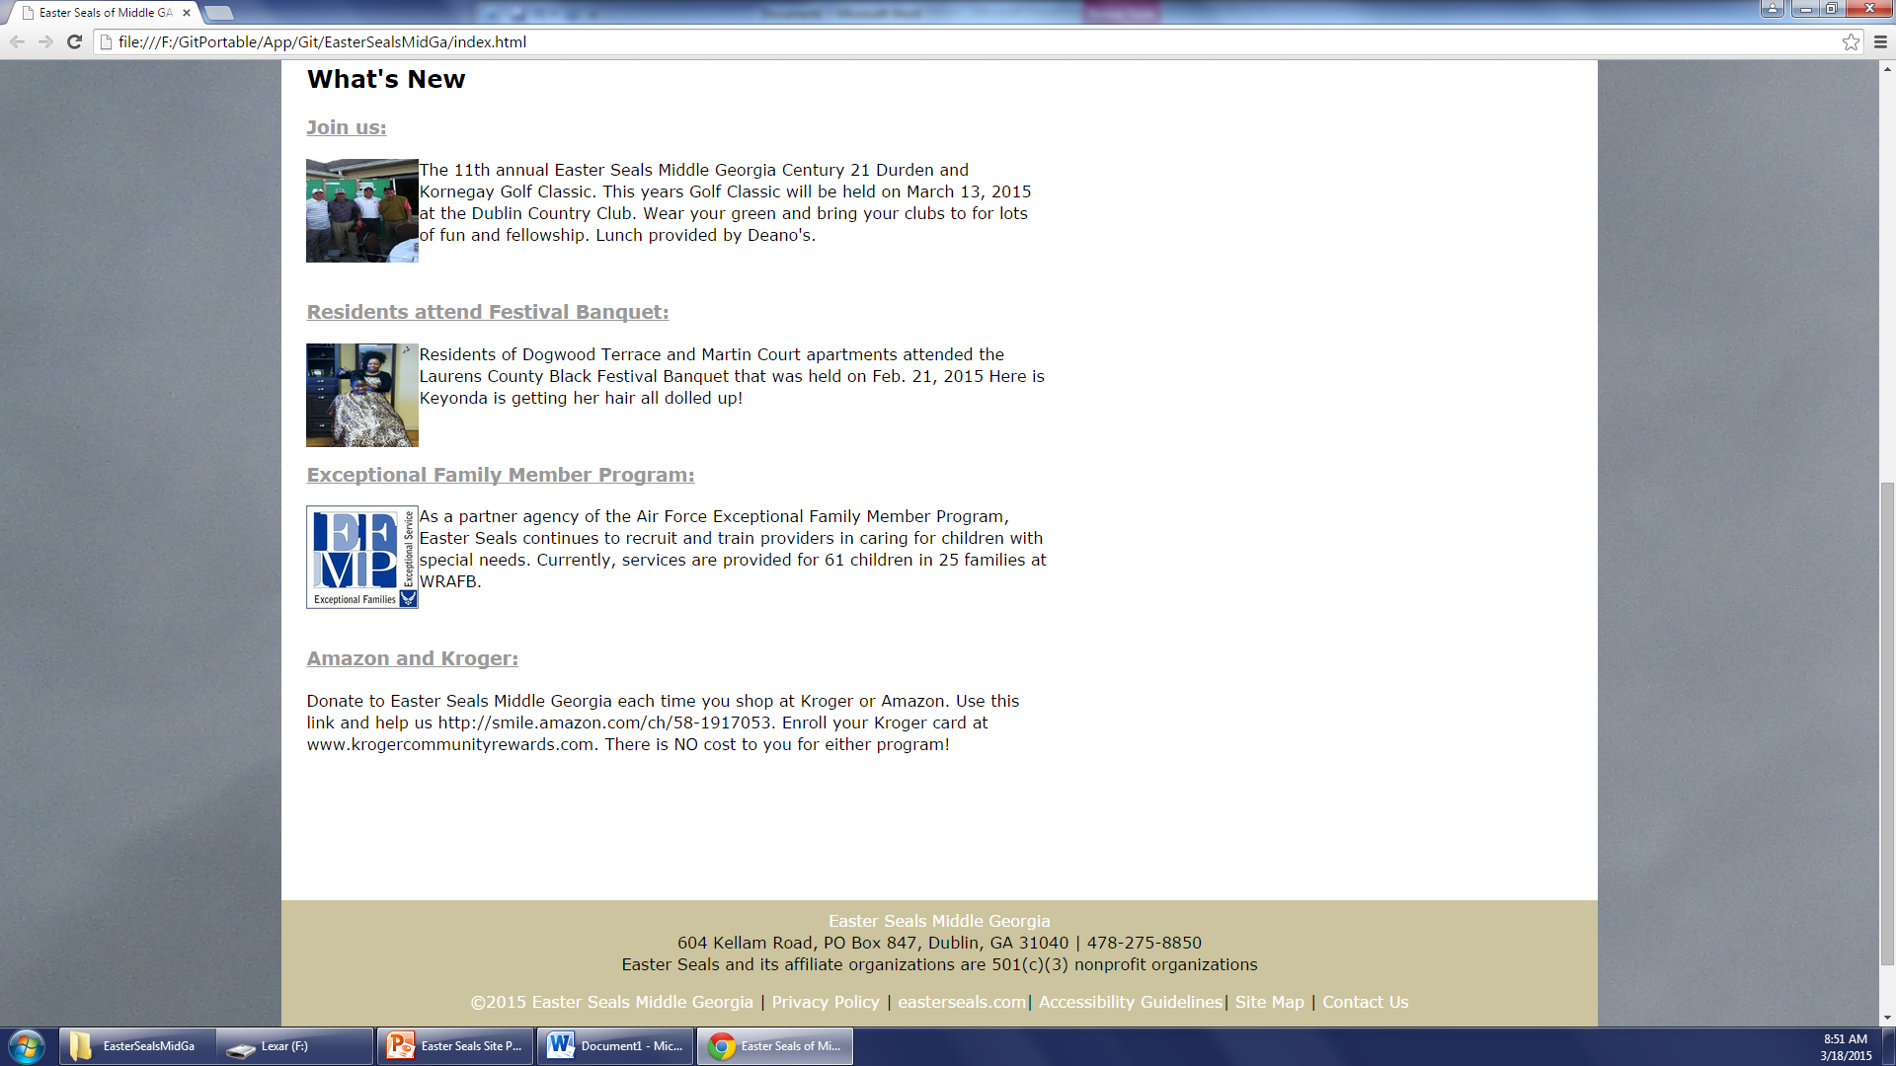
Our Site

